Slide 1
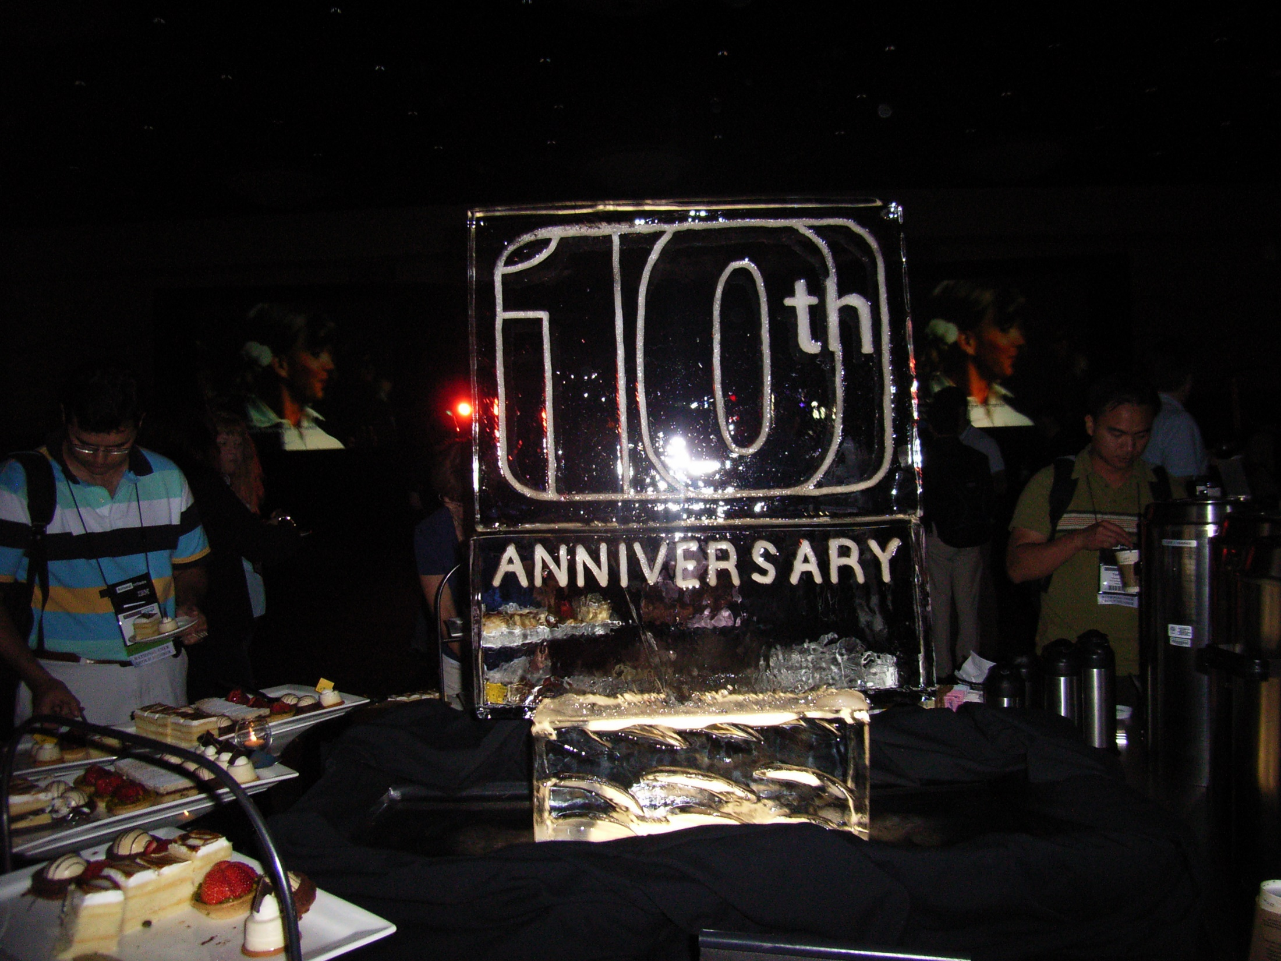


Slide 2

Welcome
to our

Slide 3

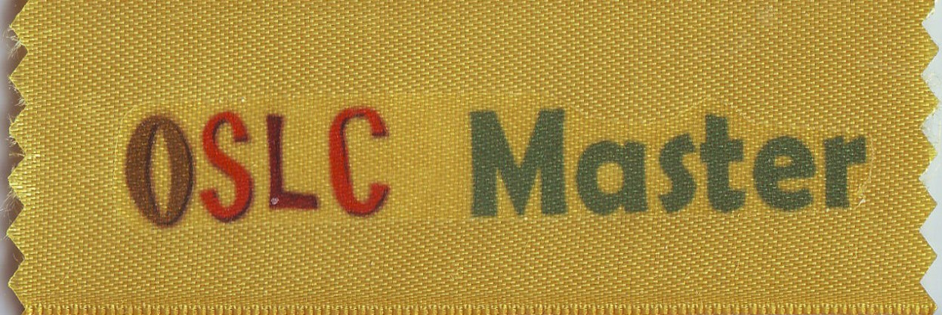

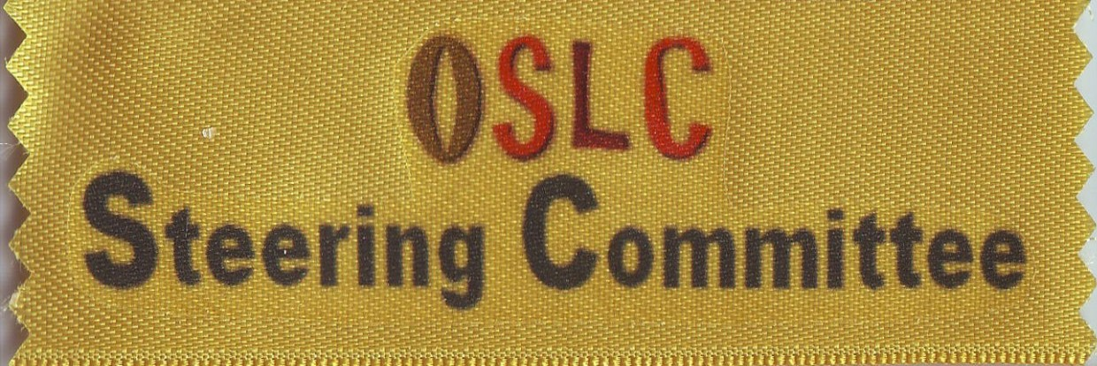


Slide 4


Slide 5
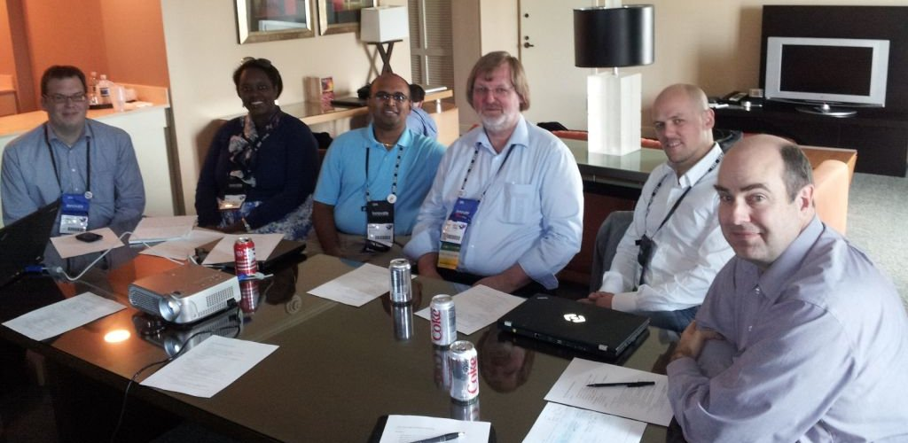
First OASIS OSLC Steering Committee

Slide 6
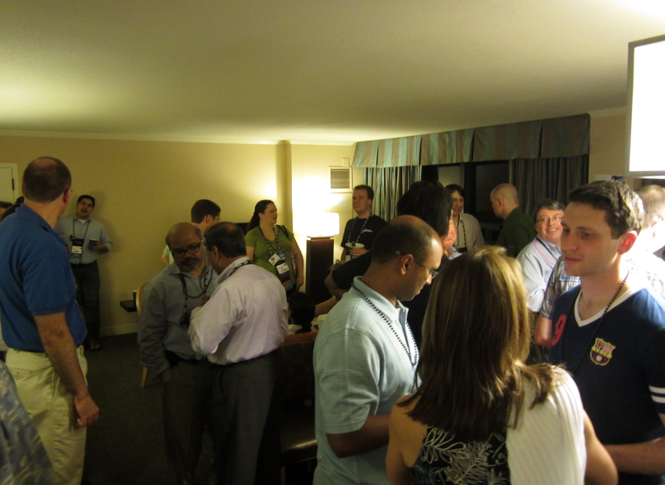
OSLC Hospitality Suite

Slide 7
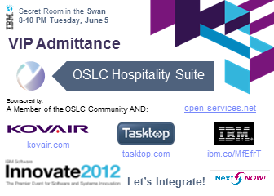
OSLC Hospitality Suite
VIP Access Pass
Until Security

Slide 8
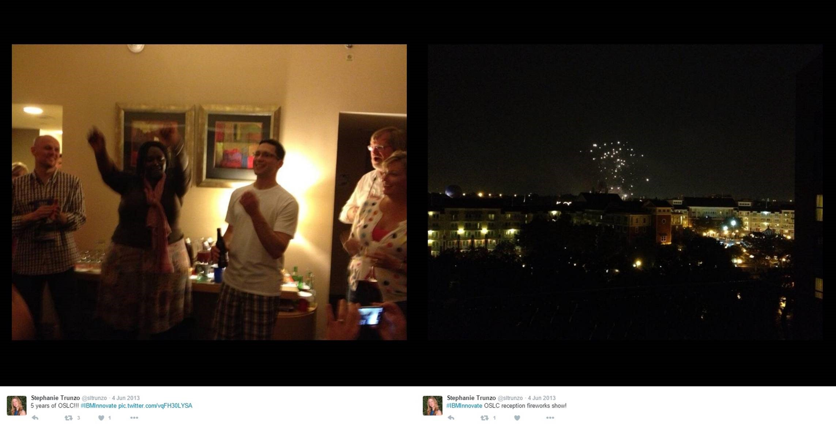
OSLC 5th Anniversary
with cake and fireworks

Slide 9
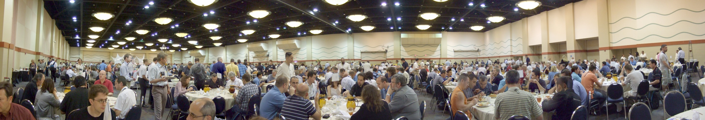
Famous Orlando Breakfast Room
place of birth of some OSLC groups
RM
Working Group
CM
Working Group
ALM PLM
User Group

Slide 10
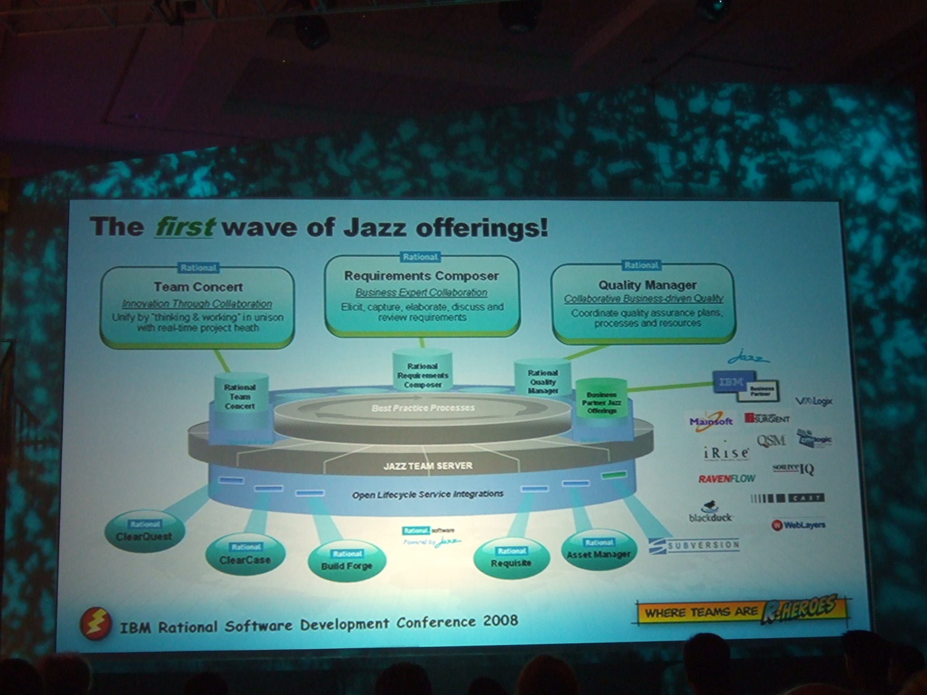

Slide 11
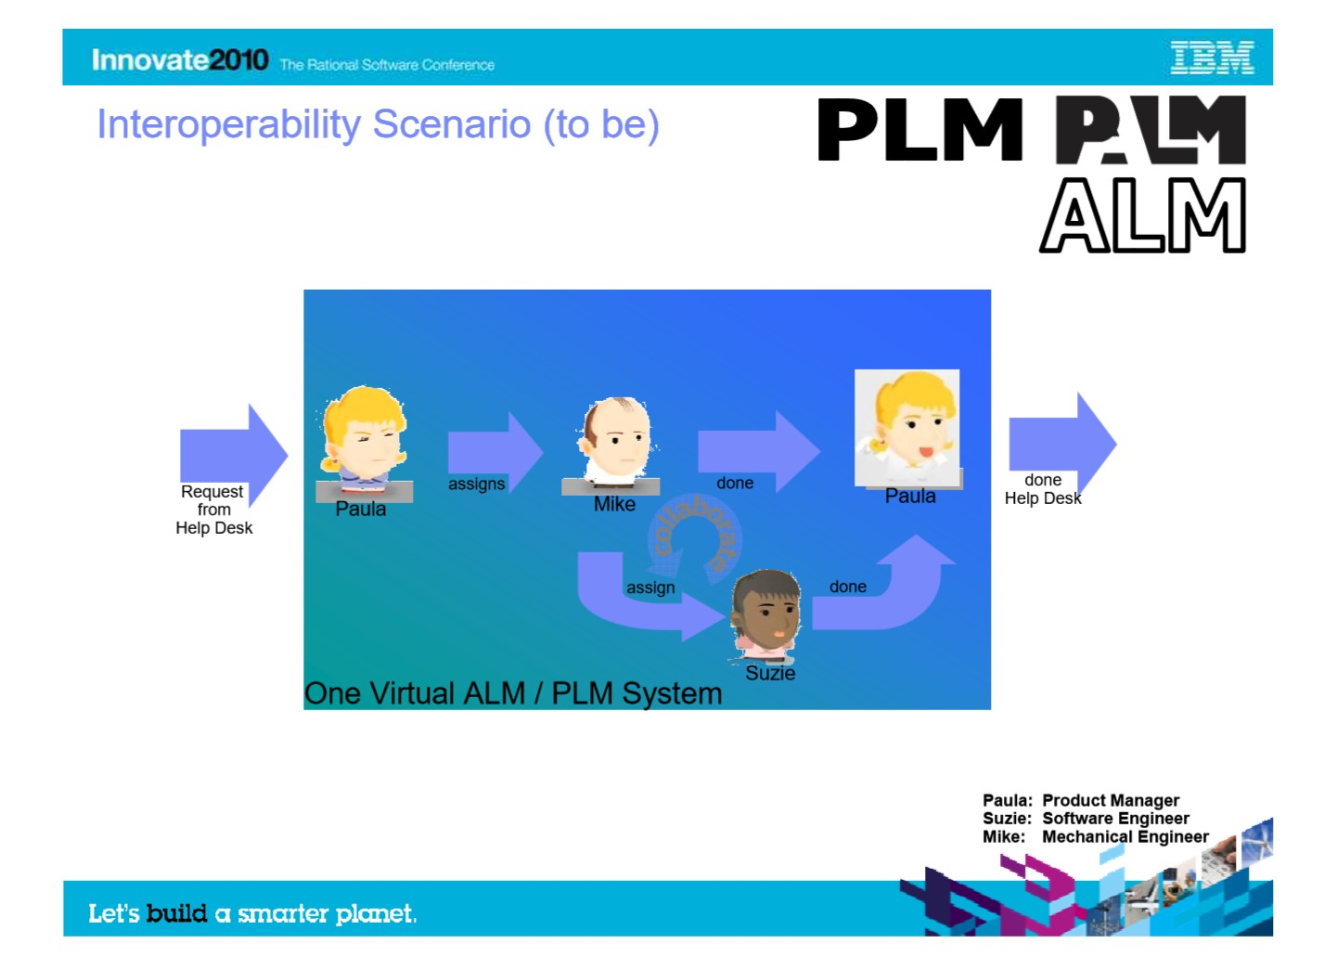
First OSLC ALM PLM Presentation

Slide 12
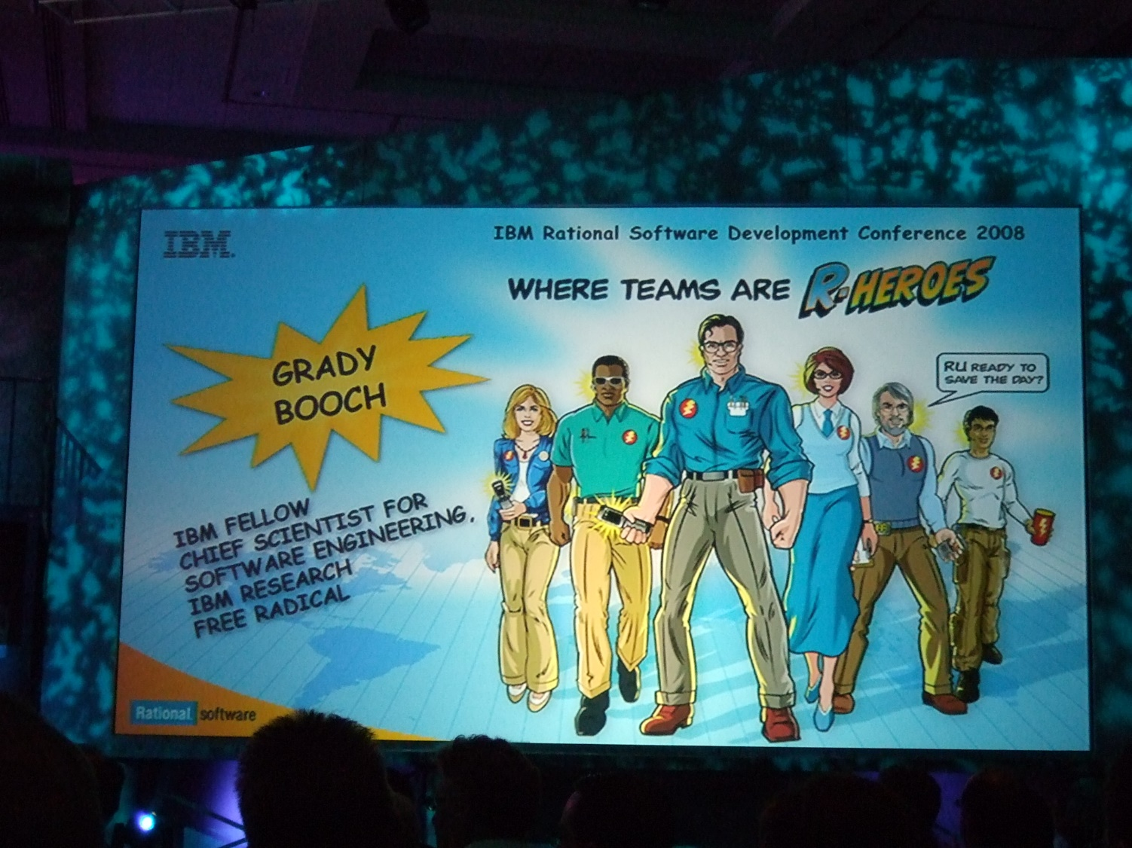
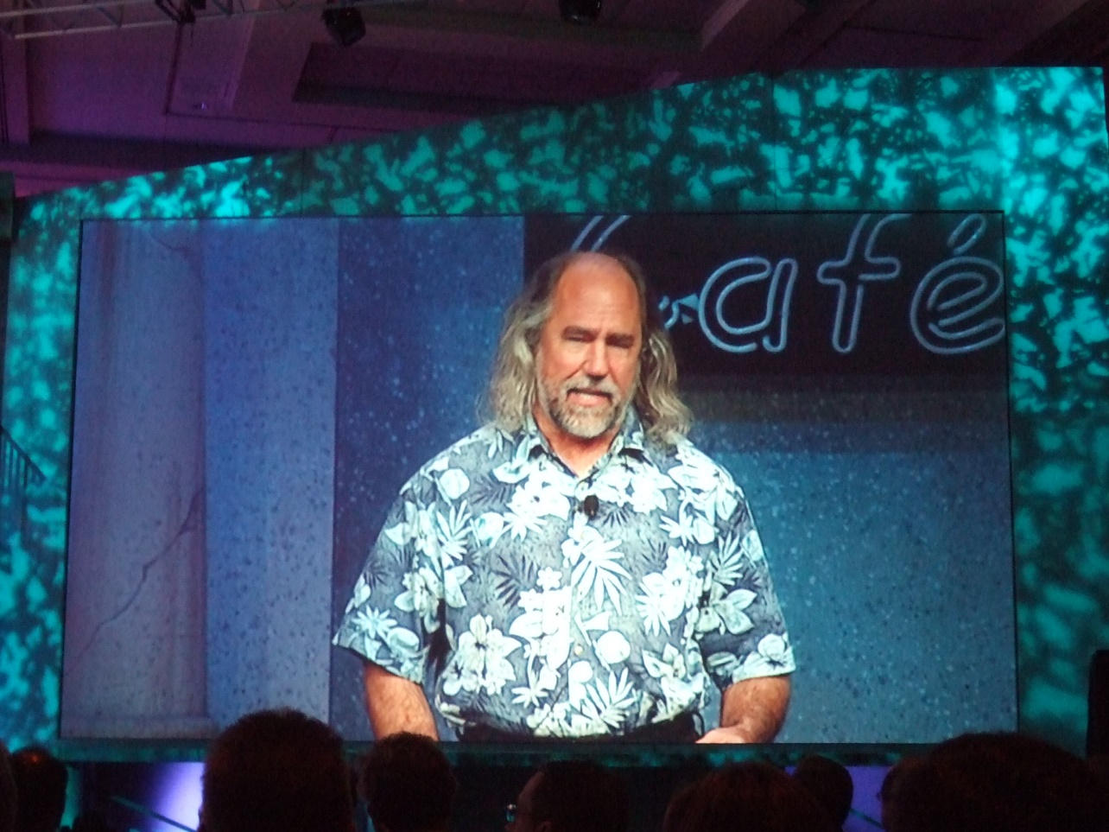
Grady Booch, father of many things
and “free radical”

Slide 13
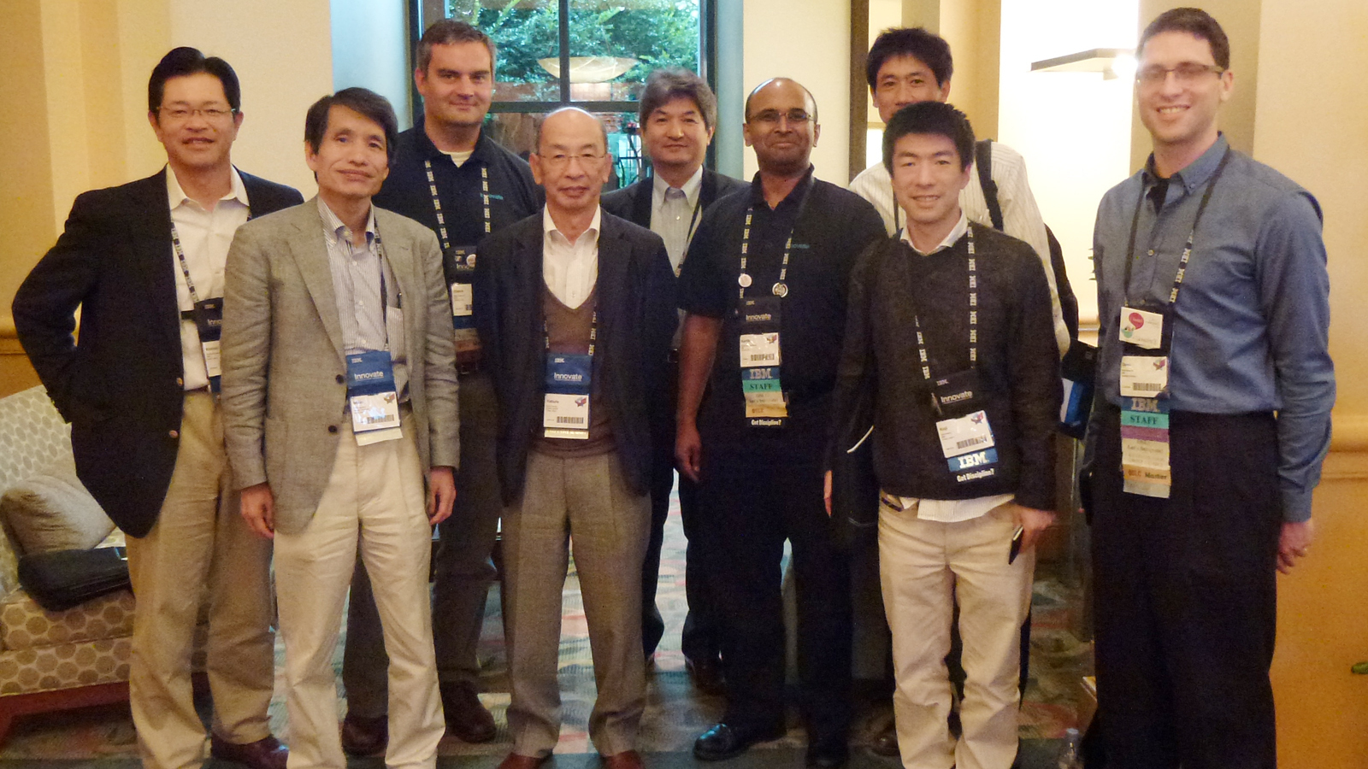
oslc-promcode
OSLC Promcode Team Japan

Slide 14
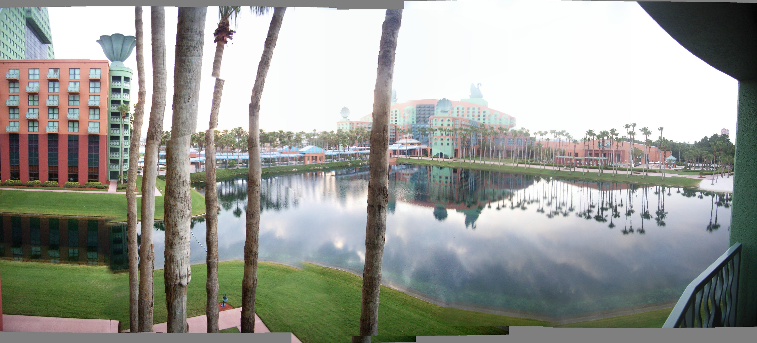
OSLC at Swan & Dolphin Orlando

